Slide 1
Help Wanted Online A real-time measure of job postings
August 2023
Office of Research Connecticut Department of Labor
Connecticut Department of Labor – Research Office 200 Folly Brook Blvd. Wethersfield, CT 06109
Help Wanted Online

Slide 2
What is HWOL?
The Conference Board Help Wanted Online® Data Series (HWOL) measures the number of new, first-time Online job postings and jobs reposted from the previous month for over 50,000 Internet job boards, corporate boards and smaller job sites that serve niche markets and smaller geographic areas. This document contains information on monthly total job ad counts for July 2023.
Connecticut Department of Labor – Research Office 200 Folly Brook Blvd. Wethersfield, CT 06109
Help Wanted Online

Slide 3
Upcoming Release Dates
Monthly Report: September 11th, 2023 Weekly New Ads Report: Updated every Tuesday
Connecticut Department of Labor – Research Office 200 Folly Brook Blvd. Wethersfield, CT 06109
Help Wanted Online

Slide 4
Statewide Weekly HWOL New Job Ads
Information on weekly new job ads by Employer, Industry, and Occupation can be found at: https://www1.ctdol.state.ct.us/lmi/hwol.asp This Information is updated every Tuesday.
Connecticut Department of Labor – Research Office 200 Folly Brook Blvd. Wethersfield, CT 06109
Help Wanted Online

Slide 5
Statewide Monthly Highlights
- Total postings in Connecticut was 89,208 in July 2023, up slightly from 89,167 in June 2023. -Industry sectors with the most job postings were Health Care and Social Assistance (16,964 postings), Retail Trade (8,886 posting), Manufacturing (6,788 postings), and Pro., Sci., & Tech. Services (5,525 postings).
-Occupations with the most postings were Registered Nurses (5,216 postings), Retail Salespersons (3,391 postings), Supervisors of Retail Sales Workers (2,391 postings), and Wholesale & Manufacturing Sales Representatives (1,707 postings).
Connecticut Department of Labor – Research Office 200 Folly Brook Blvd. Wethersfield, CT 06109
Help Wanted Online

Slide 6
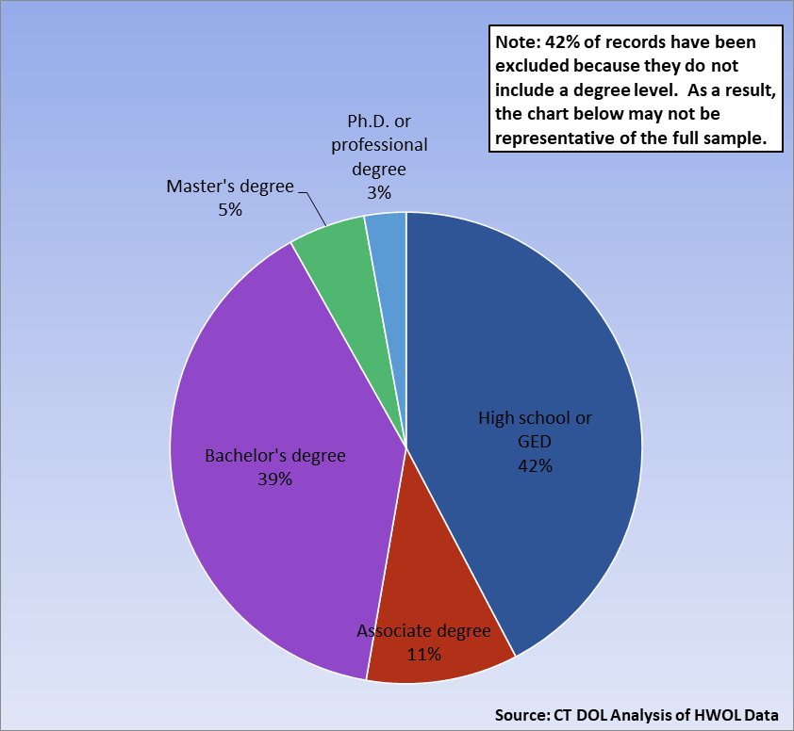
Connecticut Job Ads by Educational Requirements
Connecticut Department of Labor – Research Office 200 Folly Brook Blvd. Wethersfield, CT 06109
Help Wanted Online

Slide 7
Top Qualifications in Connecticut Job Ads
Connecticut Department of Labor – Research Office 200 Folly Brook Blvd. Wethersfield, CT 06109
Help Wanted Online

Slide 8
Top Skills in Connecticut Job Ads
Connecticut Department of Labor – Research Office 200 Folly Brook Blvd. Wethersfield, CT 06109
Help Wanted Online

Slide 9
Connecticut Department of Labor – Research Office 200 Folly Brook Blvd. Wethersfield, CT 06109
Help Wanted Online

Slide 10
Connecticut Employers with the Most Job Ads
Connecticut Department of Labor – Research Office 200 Folly Brook Blvd. Wethersfield, CT 06109
Help Wanted Online

Slide 11
Connecticut Occupations with the Most Job Ads
Connecticut Department of Labor – Research Office 200 Folly Brook Blvd. Wethersfield, CT 06109
Help Wanted Online

Slide 12
Workforce Area Data
Workforce Area Highlights
Job Ads by Industry
Job Ads by Location
Employers With The Most Job Ads
Occupations With The Most Job Ads
Connecticut Department of Labor – Research Office 200 Folly Brook Blvd. Wethersfield, CT 06109
Help Wanted Online

Slide 13
Workforce Area Highlights
Connecticut Department of Labor – Research Office 200 Folly Brook Blvd. Wethersfield, CT 06109
Help Wanted Online

Slide 14
Connecticut Department of Labor – Research Office 200 Folly Brook Blvd. Wethersfield, CT 06109
Help Wanted Online

Slide 15
Eastern Workforce Job Ads by Location
Connecticut Department of Labor – Research Office 200 Folly Brook Blvd. Wethersfield, CT 06109
Help Wanted Online

Slide 16
Eastern Workforce Employers
with the Most Job Ads
Connecticut Department of Labor – Research Office 200 Folly Brook Blvd. Wethersfield, CT 06109
Help Wanted Online

Slide 17
Eastern WDA Occupations
with the Most Job Ads
Connecticut Department of Labor – Research Office 200 Folly Brook Blvd. Wethersfield, CT 06109
Help Wanted Online

Slide 18
Connecticut Department of Labor – Research Office 200 Folly Brook Blvd. Wethersfield, CT 06109
Help Wanted Online
18

Slide 19
North Central WDA Job Ads by Location
Connecticut Department of Labor – Research Office 200 Folly Brook Blvd. Wethersfield, CT 06109
Help Wanted Online

Slide 20
North Central WDA Employers
with the Most Job Ads
Connecticut Department of Labor – Research Office 200 Folly Brook Blvd. Wethersfield, CT 06109
Help Wanted Online

Slide 21
North Central WDA Occupations
with the Most Job Ads
Connecticut Department of Labor – Research Office 200 Folly Brook Blvd. Wethersfield, CT 06109
Help Wanted Online

Slide 22
Connecticut Department of Labor – Research Office 200 Folly Brook Blvd. Wethersfield, CT 06109
Help Wanted Online

Slide 23
Northwest WDA Job Ads by Location
Connecticut Department of Labor – Research Office 200 Folly Brook Blvd. Wethersfield, CT 06109
Help Wanted Online

Slide 24
Northwest WDA Employers
with the Most Job Ads
Connecticut Department of Labor – Research Office 200 Folly Brook Blvd. Wethersfield, CT 06109
Help Wanted Online

Slide 25
Northwest WDA Occupations
with the Most Job Ads
Connecticut Department of Labor – Research Office 200 Folly Brook Blvd. Wethersfield, CT 06109
Help Wanted Online

Slide 26
Connecticut Department of Labor – Research Office 200 Folly Brook Blvd. Wethersfield, CT 06109
Help Wanted Online

Slide 27
South Central WDA Job Ads by Location
Connecticut Department of Labor – Research Office 200 Folly Brook Blvd. Wethersfield, CT 06109
Help Wanted Online

Slide 28
South Central WDA Employers
with the Most Job Ads
Connecticut Department of Labor – Research Office 200 Folly Brook Blvd. Wethersfield, CT 06109
Help Wanted Online

Slide 29
South Central WDA Occupations
with the Most Job Ads
Connecticut Department of Labor – Research Office 200 Folly Brook Blvd. Wethersfield, CT 06109
Help Wanted Online

Slide 30
Connecticut Department of Labor – Research Office 200 Folly Brook Blvd. Wethersfield, CT 06109
Help Wanted Online

Slide 31
Southwest WDA Job Ads by Location
Connecticut Department of Labor – Research Office 200 Folly Brook Blvd. Wethersfield, CT 06109
Help Wanted Online

Slide 32
Southwest WDA Employers
with the Most Job Ads
Connecticut Department of Labor – Research Office 200 Folly Brook Blvd. Wethersfield, CT 06109
Help Wanted Online

Slide 33
Southwest WDA Occupations
with the Most Job Ads
Connecticut Department of Labor – Research Office 200 Folly Brook Blvd. Wethersfield, CT 06109
Help Wanted Online

Slide 34
All advertisement data used in this publication is from the Conference Board’s Help Wanted Online data series.
For more information or data requests, contact Matthew Krzyzek in the Office of Research at the Department of Labor.
Matthew.Krzyzek@ct.gov
For more Connecticut Labor Market Information visit:
www.ctdol.state.ct.us/lmi
https://www.facebook.com/ctlmi
Twitter: @DOL_Research
Connecticut Department of Labor – Research Office 200 Folly Brook Blvd. Wethersfield, CT 06109
Help Wanted Online

